Slide 1
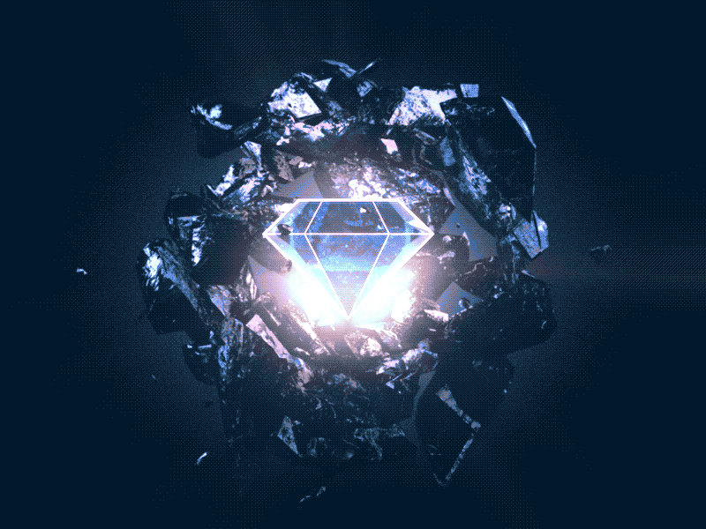
xalmas - Ecosystem for Digital Asset-backed investments
dalmas – digital Token backed by Diamonds
FINTECH PROGRAM – UNIVERSITY OF TORONTO
By Group 2: Mohammad Samadi, Javier Aramayo, Omar Suleiman, Abhilesh Gaikwad, Saiful Ahmed, Ali Ze
November 10, 2022

Slide 2
AGENDA
SUMMARY – WHAT ARE WE SOLVING? - Saiful
PROBLEM & SOLUTIONS IDENTIFICATION - ali
BUSINESS PROCESS FLOWCHART -javier
Xalmas Ecosystem - mohammad
Xalmas Technical:
XALMAS NFT CONTRACT - abhilesh
DALMAS TOKEN CONTRACT - omar
XALMAS AUCTION & ADMIN CONTRACTS - mohammad
DEX - mohammad
SOLUTION DEMONSTRATION - mohammad
DEPLOYMENT PLAN - saiful
QUESTIONS

Slide 3
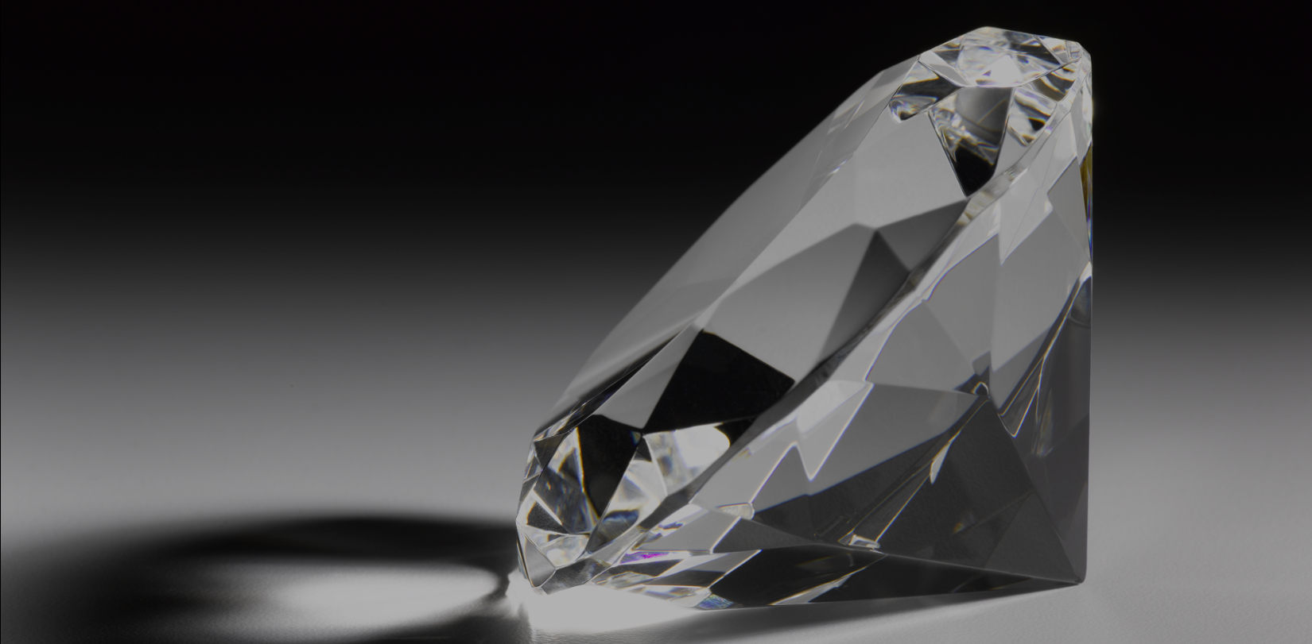
WHAT ARE WE SOLVING?
Elon D., an international diamond trader and business owner, needs to expand its market for selling more Diamonds. There is a limited number of customers that can afford buying high price diamonds. Elon hired the FinTech Group2 for providing a technology solution for selling tokens that will be backed by certified and secured high price diamonds.
Our proposal: Offering certified and high-grade diamonds as an investment opportunity registered as NFTs, and digital tokens that are backed by the diamonds and sold through the blockchain worldwide.
Diamonds are an ideal asset for backing a token since they are rare and scarce, are recognized as store of value, and their value is certifiable. Diamonds are good investment because of their continuous value appreciation.
Retail Investors are looking for better investment opportunities. The stock market and real estate are volatile, and cryptocurrencies remain a high-risk instrument.

Slide 4
Problems & Solutions Identification:
Perceived Distrust - Customers are afraid of investing in a non-physical asset that is not secured or guaranteed by a bank or financial institution | Dalmas tokens will be backed by real Diamonds, NFT registered. The NFT registers the ID number, GIA Certificate and Prize
Limited market - Very few investors would have a large capital to afford investing in high priced diamonds | A low dollar value of the Dalmas token will allow investors to afford investing with as low as a $10 USD. It will make Dalmas accessible to millions of investors
Reduced accessibility - High priced diamonds are locked or heavily secured and they are not easily accessible to customers | Dalmas tokens will be accessible to any investor around the globe that has access to the internet. Dalmas tokens can be acquired from the Xalmas site, the transaction is completed directly in the blockchain without the intervention of any third party. Dalmas investors have access to the full information of their investments.
Low Liquidity - The transaction of acquiring or selling a diamonds is complex and may require long time | Investors can get the refund for their tokens based on the updated token value. They can exchange Dalmas with other blockchain tokens via digital platforms
Skepticism to new technology - Blockchain is a new technology with a steep learning curve for investors | The site for the Dalmas will provide a user-friendly channel for investors to acquire and do transactions for tokens without the frictions of learning about blockchain technology.

Slide 5
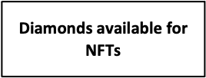
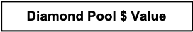
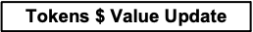
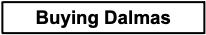
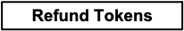
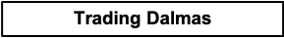
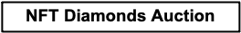
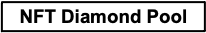
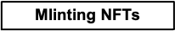
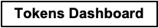
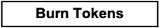
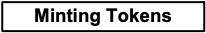
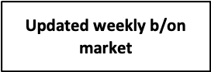
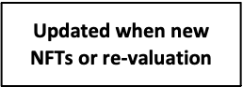
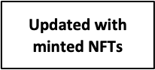
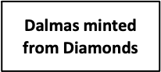
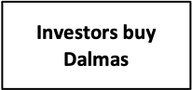
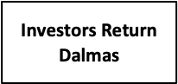
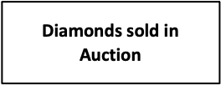
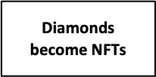
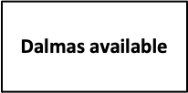
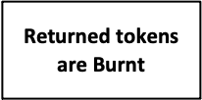
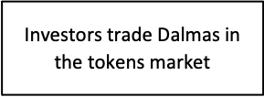
Dalmas business process flowchart

Slide 6
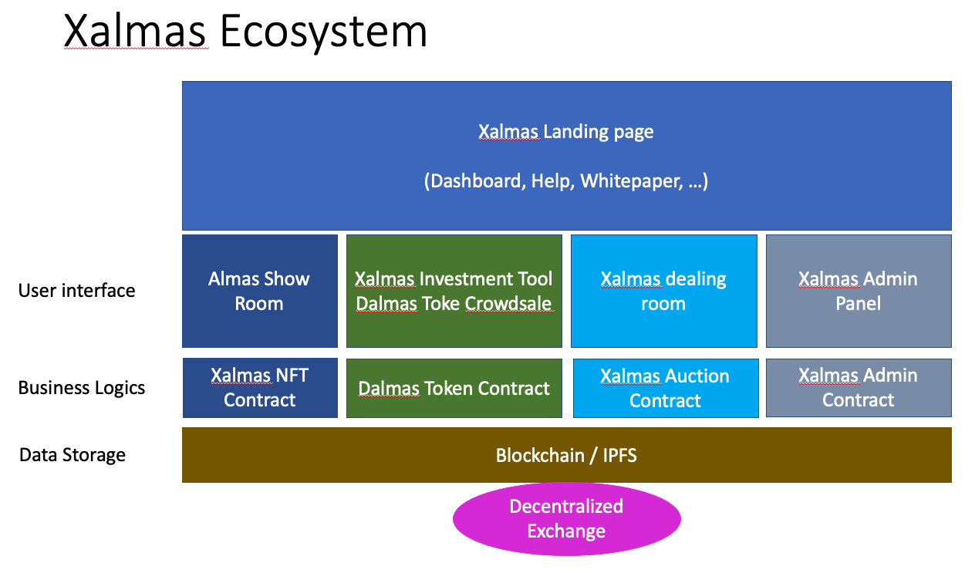
Ecosystem

Slide 7
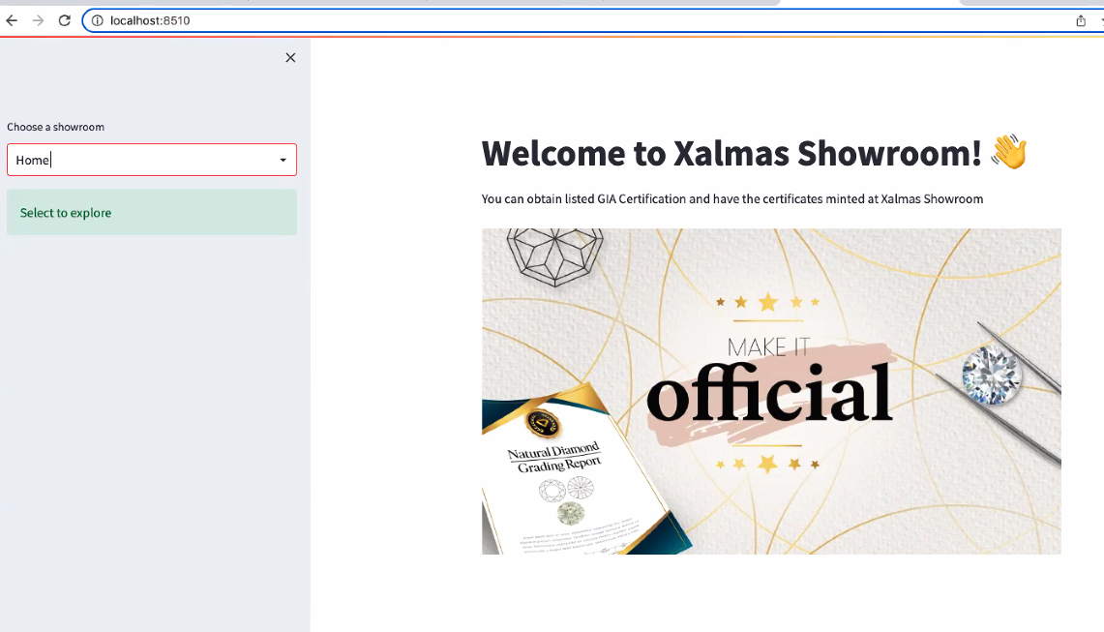
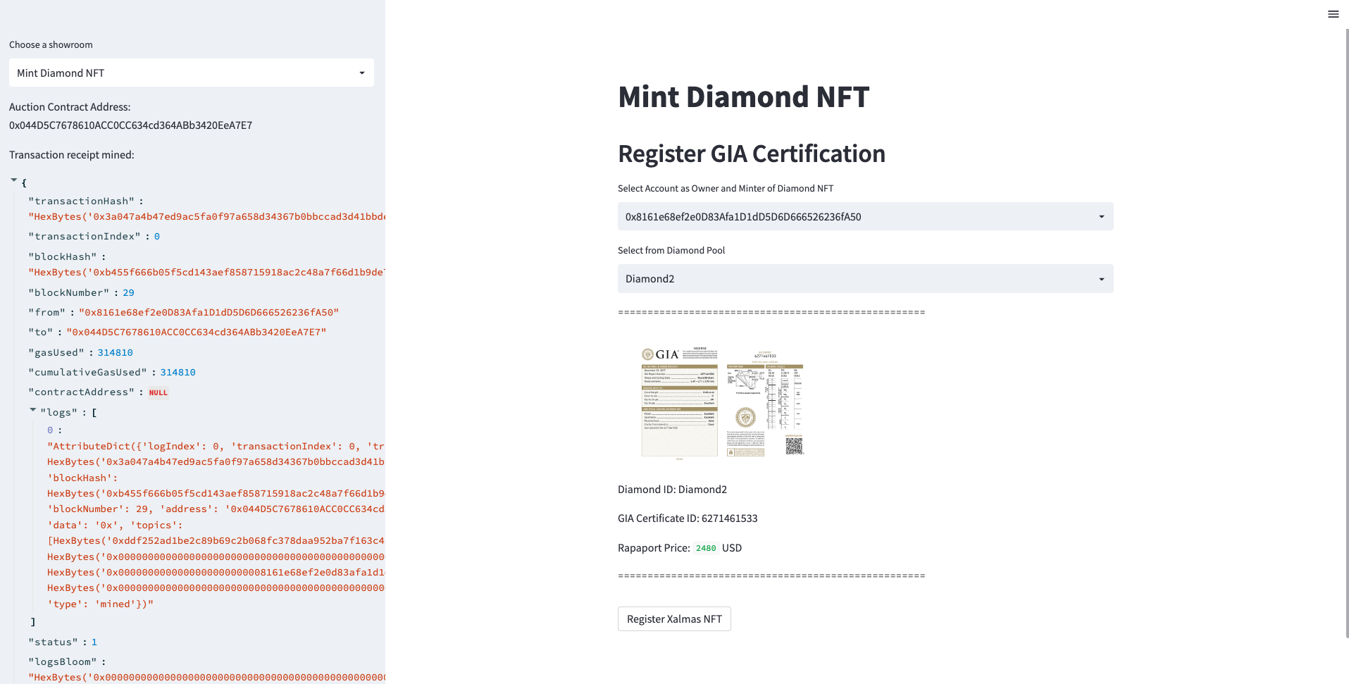
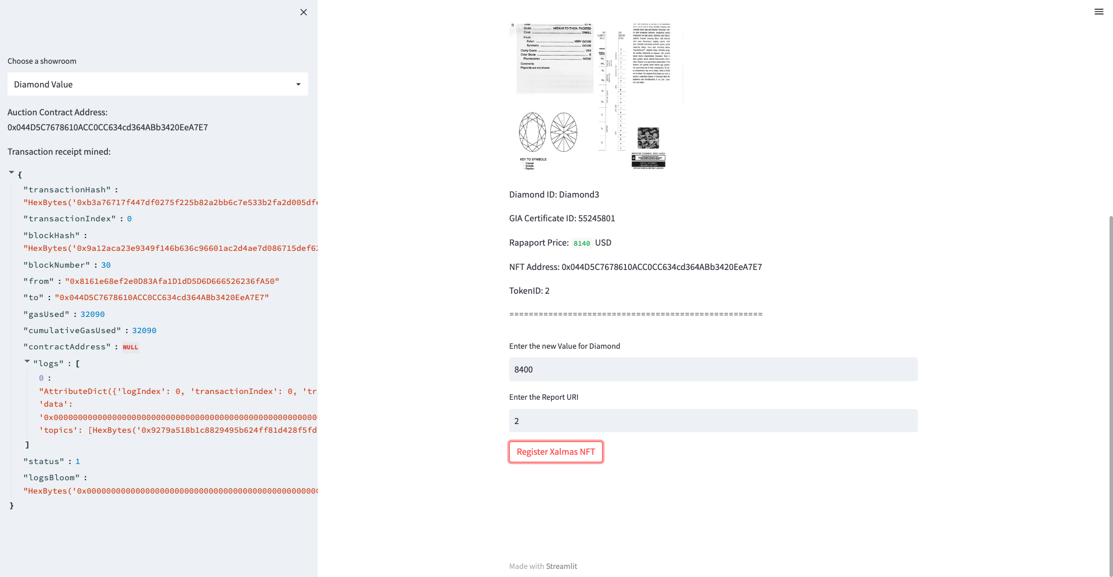
Xalmas NFT Contract
Xalmas Show Room provides a list of Diamonds and their relevant information. This application allows the minting of Diamonds and registration as NFTs and updating the values of Diamonds

Slide 8
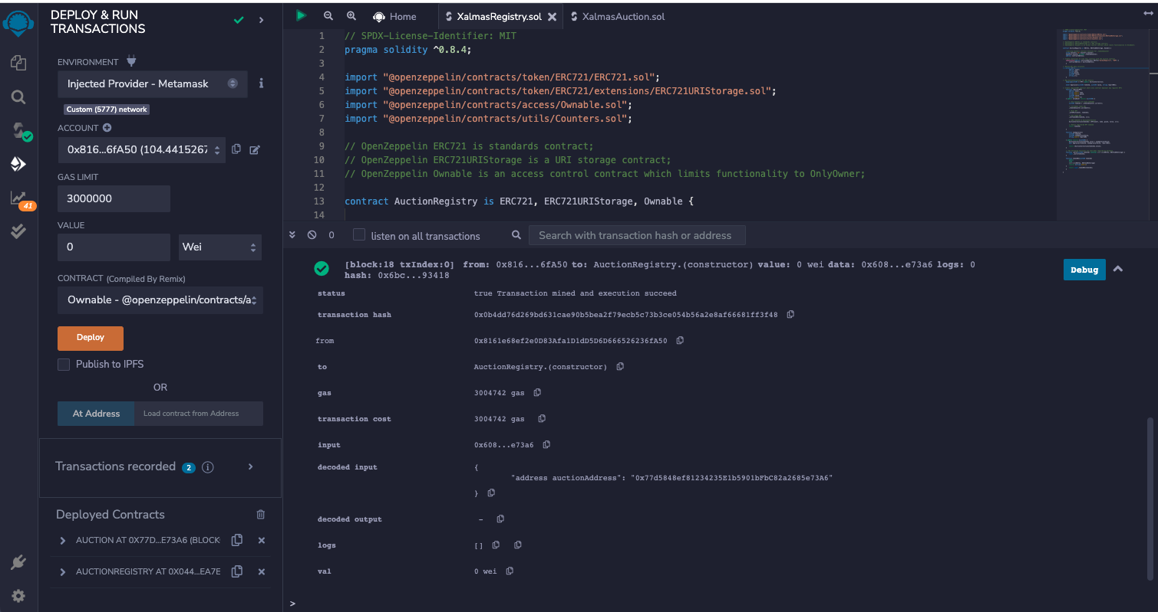
Xalmas NFT Contract

Slide 9
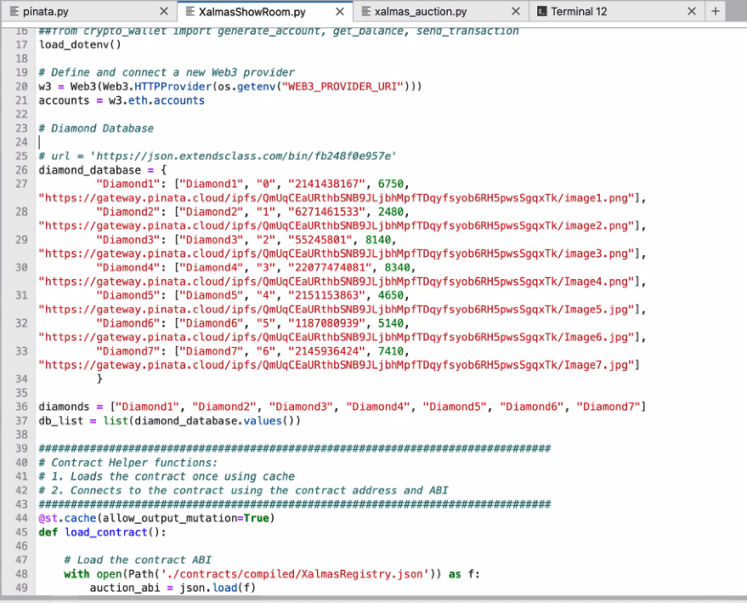
Xalmas NFT Contract

Slide 10
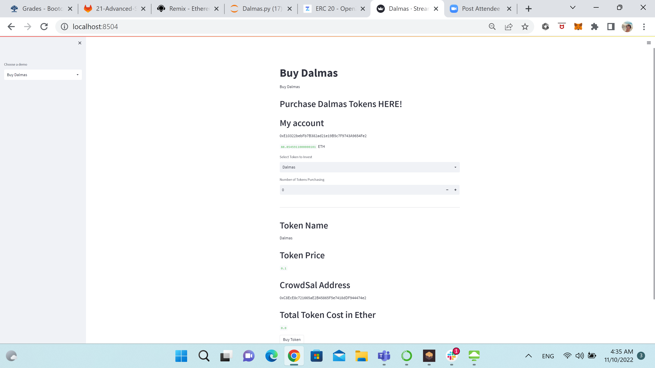
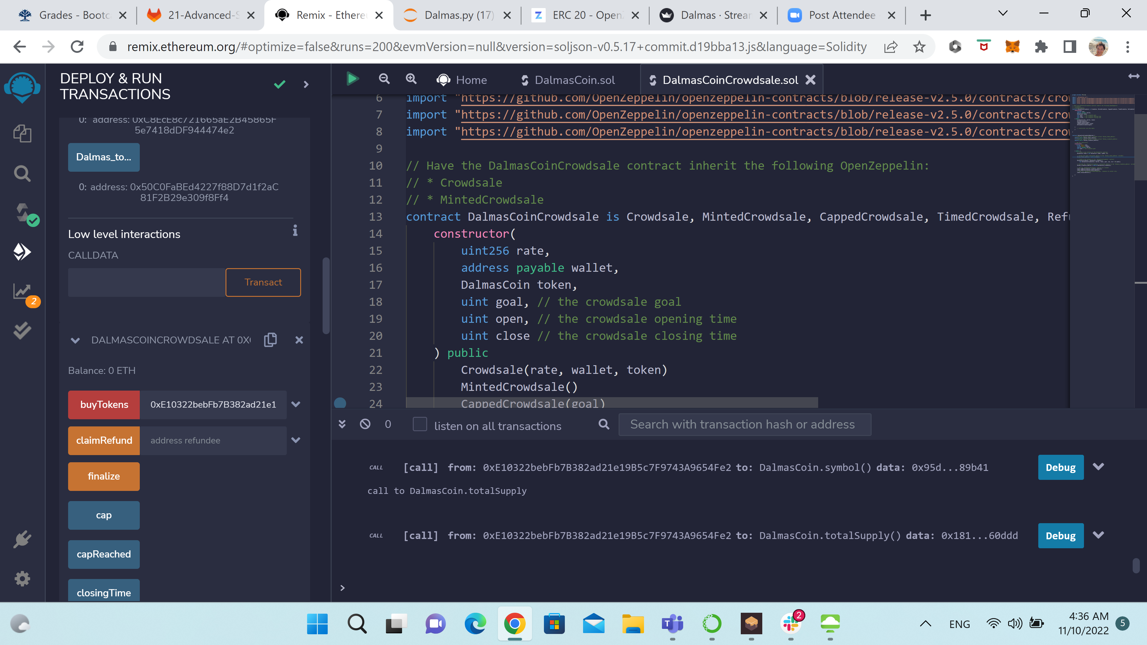
Dalmas Tokens contract
Xalmas Investment Tool (Dalmas Token) provides the tools for investors to purchase or return tokens. It provides information about total tokens and enables ADMIN to burn tokens returned.

Slide 11
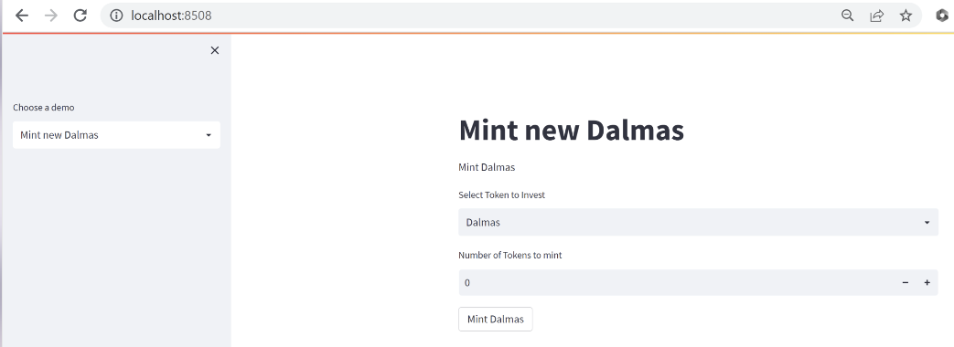
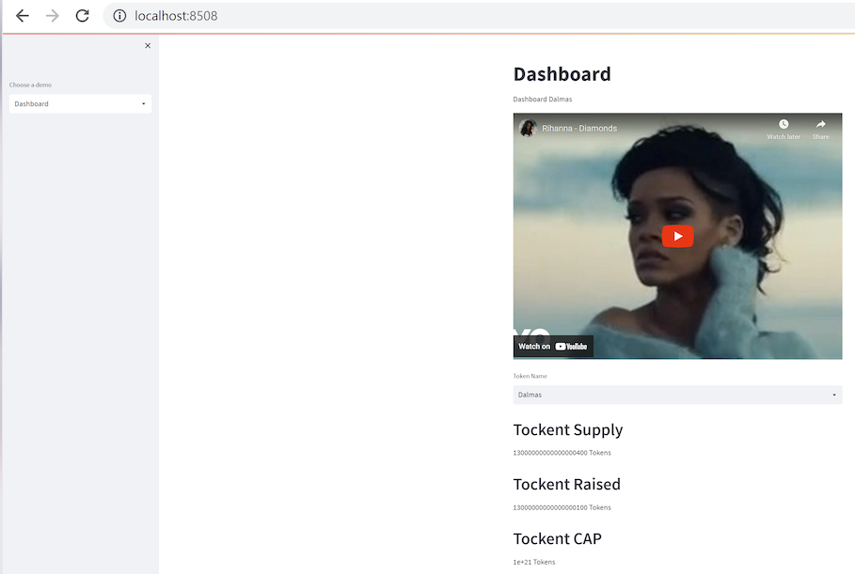
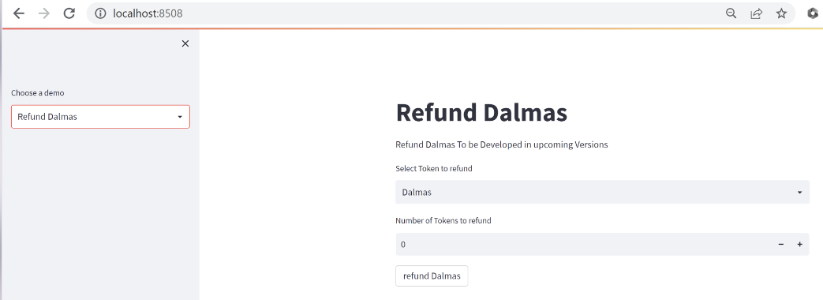
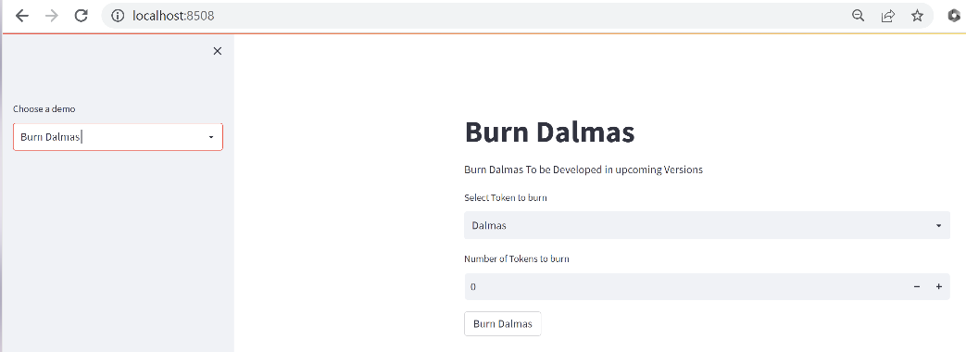
Dalmas Tokens contract

Slide 12
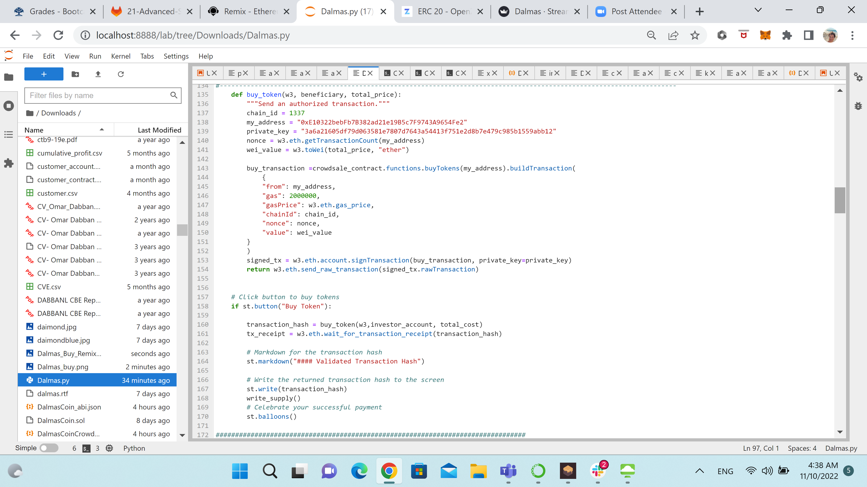
Dalmas Tokens contract

Slide 13
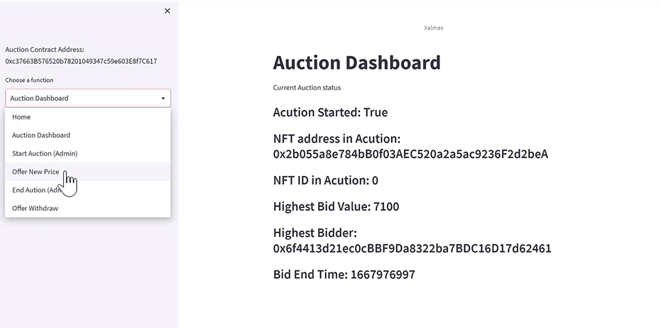
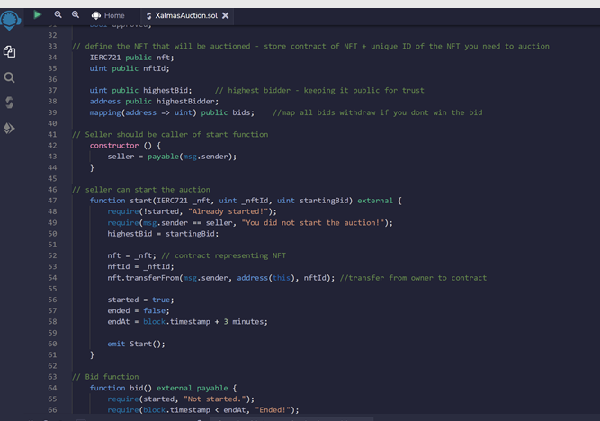
XALMAS AUCTION & ADMIN CONTRACTS
Xalmas Dealing Room This module allows the sale of Diamonds via auction to fetch the best value.

Slide 14
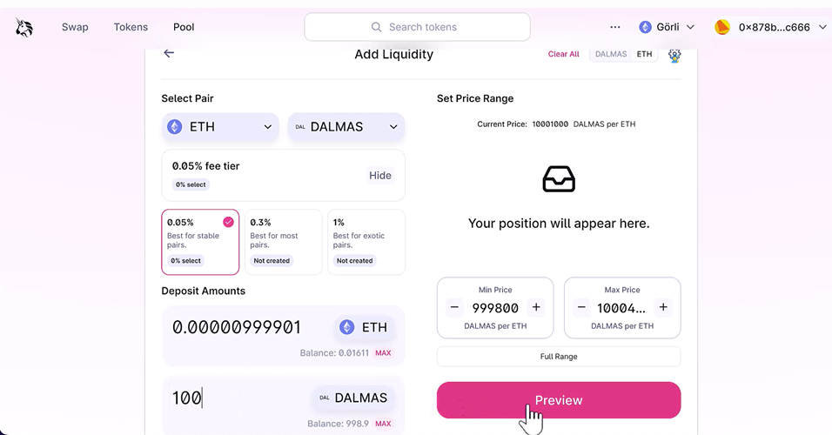
DEX

Slide 15
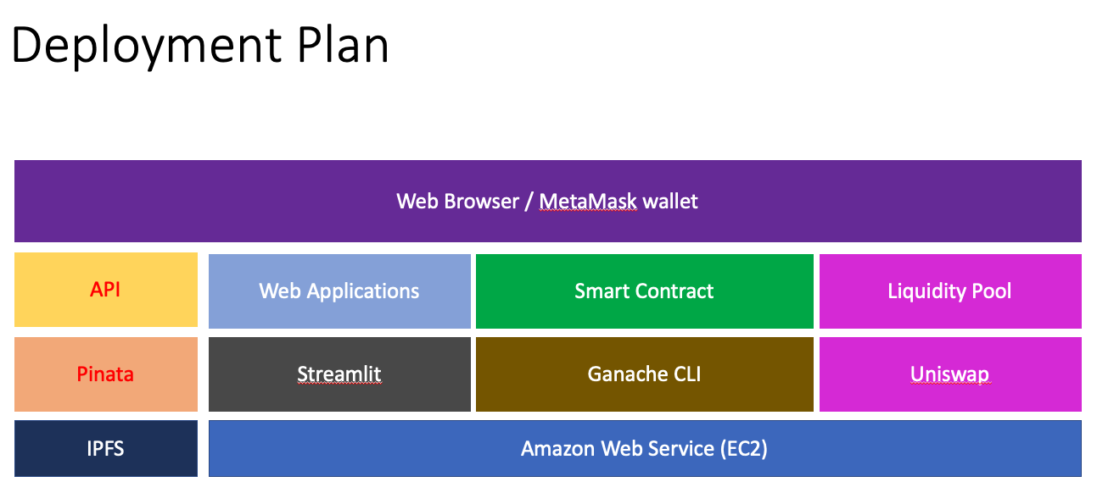

Slide 16
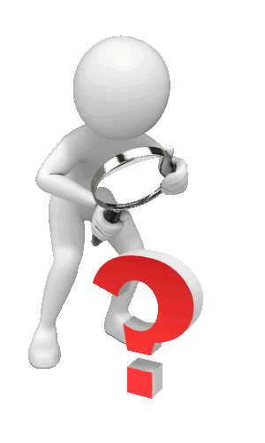

Slide 17
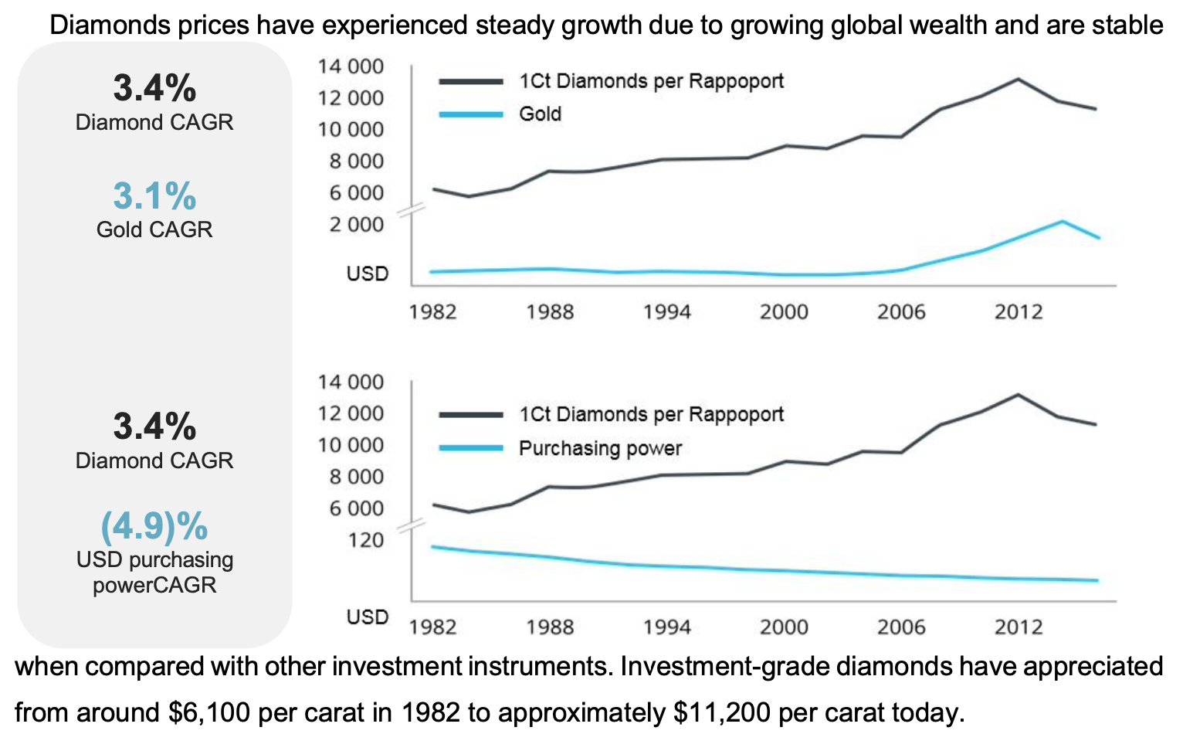
Appendix 1

